Slide 1
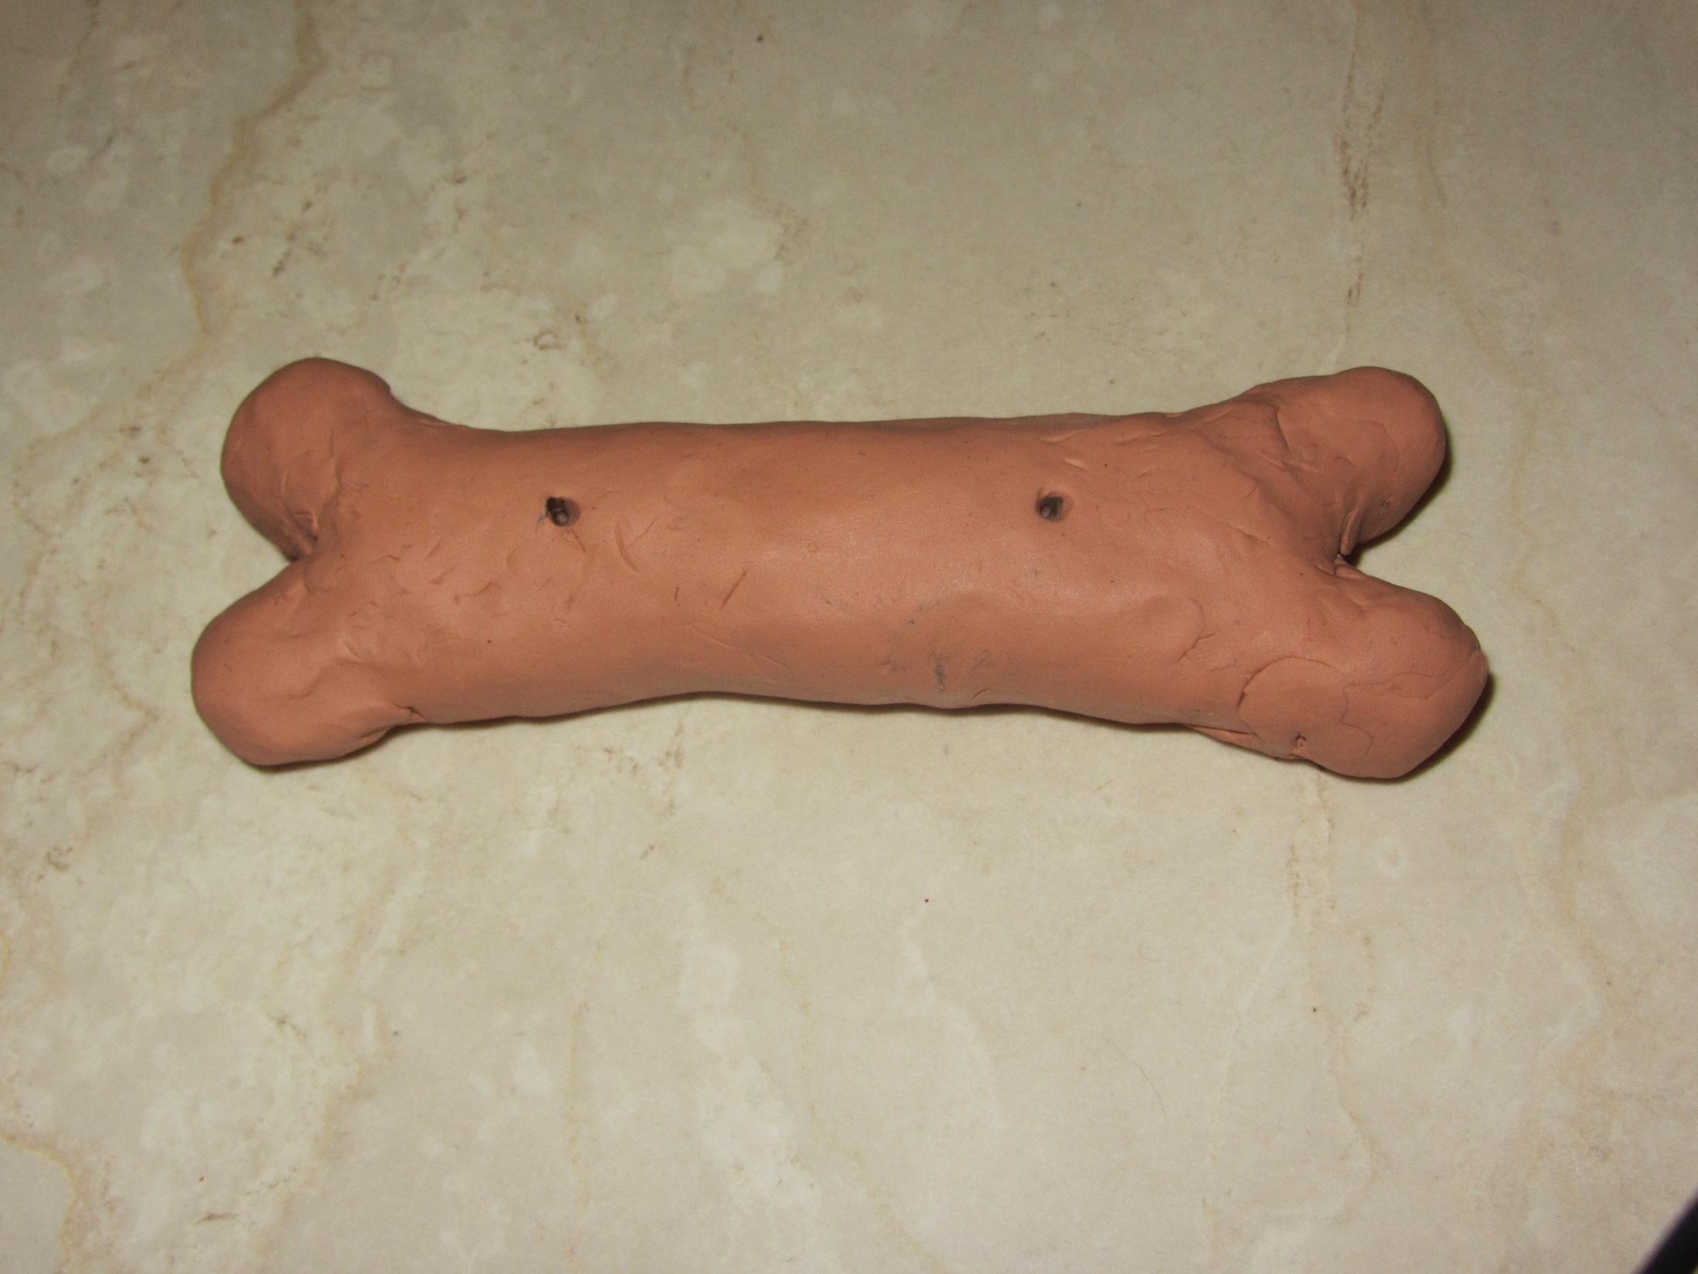
One Bone in the Body
Opening
Bone
Front Side of the Bone

Slide 2
Enamel Starts To Cover Bone From the Openings in the Bone
Bone
Enamel
Opening
Enamel
Front Side of the Bone

Slide 3
Enamel Starts to Form a Layer By Covering the Bonc Further
Opening
Enamel
Bone
Front Side of the Bone

Slide 4
Enamel Starts to Form a Layer By Covering the Bonc Further
Back Side of the Bone
Enamel
Bone

Slide 5
Enamel Almost Fully Covers the Bone–After the Enamel Fully Covers the Bone, 1-2 More Layers Will Be Added and Will Follow the Same Process
Front Side of the Bone
Enamel
Enamel
Enamel
Opening
Bone

Slide 6
Enamel Almost Fully Covers the Bone–After the Enamel Fully Covers the Bone, 1-2 More Layers Will Be Added and Will Follow the Same Process
Enamel
Bone
Enamel
Enamel
Back Side of the Bone

Slide 7
Thank You for Watching!

